Slide 1

Kotlin Syntax
Produced
by:
Dr. Siobhán Drohan (sdrohan@wit.ie)
Department of Computing and Mathematics
http://www.wit.ie/

Slide 2

Kotlin Syntax
Sources:
http://kotlinlang.org/docs/reference/basic-syntax.html
http://petersommerhoff.com/dev/kotlin/kotlin-for-java-devs/
https://www.programiz.com/kotlin-programming
https://medium.com/@napperley/kotlin-tutorial-5-basic-collections-3f114996692b

Slide 3
Agenda from last Kotlin Lecture
Basic Types
Local Variables (val & var)
Functions
Control Flow (if, when, for, while)
Strings & String Templates
Ranges (and the in operator)
Type Checks & Casts
Null Safety
Comments

Slide 4
Agenda for this Kotlin Lecture
Writing Classes (properties and fields)
Data Classes
Collections: Arrays and Collections
Collections: in operator and lambdas
Arguments (default and named)

Slide 5
Writing Classes
Properties and Fields

Slide 6
Writing Classes – properties
In Kotlin, classes cannot have fields; they have properties.
var properties are mutable.
val properties cannot be changed.

Slide 7

Writing Classes – constructors
A class in Kotlin can have a primary constructor and one or more secondary constructors.
The primary constructor is part of the class header and it goes after the class name:
class Person constructor(firstName: String) {
}
class Person(firstName: String, lastName: String) {
}
class Person(val firstName: String, val lastName: String) {
}
Notes:
If the primary constructor does not have any annotations or visibility modifiers, the constructor keyword can be omitted

Slide 8
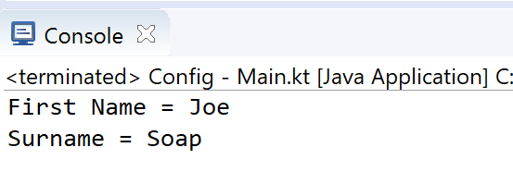

Writing Classes – primary constructors
class Person(val firstName: String, val lastName: String) {
}
fun main(args: Array<String>) {
val person = Person("Joe", "Soap")
println("First Name = ${person.firstName}")
println("Surname = ${person.lastName}")
}
Notes:
If the primary constructor does not have any annotations or visibility modifiers, the constructor keyword can be omitted

Slide 9

class Person( _firstName: String = "UNKNOWN FIRSTNAME", _lastName: String = "UNKNOWN LASTNAME") {
val firstName = _firstName
val lastName = _lastName
// initializer block
init {
println("First Name = $firstName")
println("Last Name = $lastName\n")
}
}
Writing Classes – primary constructors
The primary constructor cannot contain any code; initialisation code is placed in the init block.
The use of _ prefixing constructor variables is standard.

Slide 10

class Person( _firstName: String = "UNKNOWN FIRSTNAME", _lastName: String = "UNKNOWN LASTNAME") {
val firstName = _firstName
val lastName = _lastName
// initializer block
init {
println("First Name = $firstName")
println("Last Name = $lastName\n")
}
}
Writing Classes – primary constructors
fun main(args: Array<String>) {
println("person1 is instantiated")
val person1 = Person("Joe", "Soap")
println("person2 is instantiated")
val person2 = Person("Jack")
println("person3 is instantiated")
val person3 = Person()
}
Notes:
If the primary constructor does not have any annotations or visibility modifiers, the constructor keyword can be omitted

Slide 11
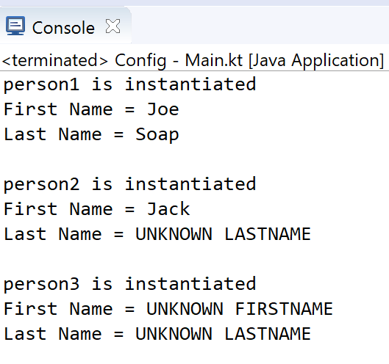

class Person( _firstName: String = "UNKNOWN FIRSTNAME", _lastName: String = "UNKNOWN LASTNAME") {
val firstName = _firstName
val lastName = _lastName
// initializer block
init {
println("First Name = $firstName")
println("Last Name = $lastName\n")
}
}
Writing Classes – primary constructors
fun main(args: Array<String>) {
println("person1 is instantiated")
val person1 = Person("Joe", "Soap")
println("person2 is instantiated")
val person2 = Person("Jack")
println("person3 is instantiated")
val person3 = Person()
}
Note: varied parameters allowed in primary constructor as values are defaulted (i.e. optional parameters)
Notes:
If the primary constructor does not have any annotations or visibility modifiers, the constructor keyword can be omitted

Slide 12
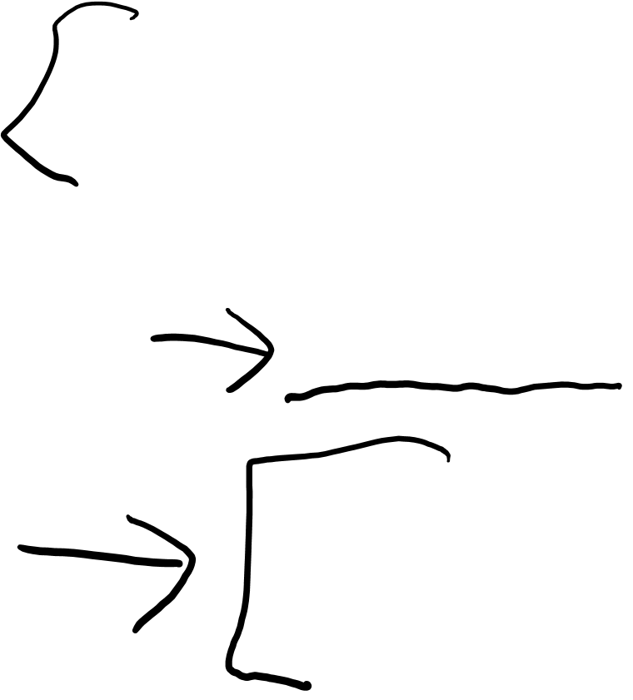
Writing Classes – secondary constructors
The secondary constructor is prefixed with the keyword constructor. They are not very common in Kotlin.
More info here: http://kotlinlang.org/docs/reference/classes.html
class Person {
constructor(parent: Person) {
parent.children.add(this)
}
}
Notes:
https://www.programiz.com/kotlin-programming/constructors

Slide 13

Writing Classes – getters and setters
In Kotlin, getters (val and var) and setters (var) are optional and are auto-generated if you do not create them in your program.
class Person {
var name: String = "defaultValue"
}
class Person {
var name: String = "defaultValue"
// getter
get() = field
// setter
set(value) {
field = value
}
}
Is equivalent to
Notes:
https://www.programiz.com/kotlin-programming/constructors
Note:- The getters and setters are only created for mutable properties (var) and for immutable properties only getter is created.

Slide 14
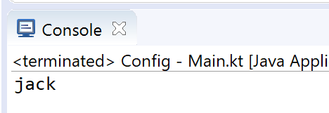

Writing Classes – getters and setters
fun main(args: Array<String>) {
val person = Person()
person.name = "jack"
print(person.name)
}
class Person {
var name: String = "defaultValue"
// getter
get() = field
// setter
set(value) {
field = value
}
}
Notes:
https://www.programiz.com/kotlin-programming/constructors

Slide 15
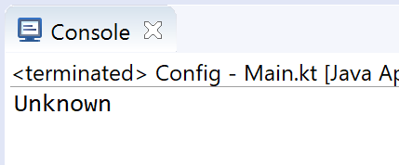

Writing Classes – getters and setters
fun main(args: Array<String>) {
val person = Person()
person.name = ""
print(person.name)
}
class Person {
var name: String = "defaultValue"
get() = field
set(value) {
field = if (value.equals(""))
"Unknown"
else
value
}
}
When you want to add validation to your setter…

Slide 16
Data Classes

Slide 17

Data Classes
We have created classes to solely to hold data (i.e. models).
We can use the data class prefix to simply create a data class.
The compiler automatically generates methods such as equals(), hashCode(), toString(), copy() from the primary constructor.
data class Person( var firstName: String,
var lastName: String)
{
}
Notes:
https://www.programiz.com/kotlin-programming/data-class

Slide 18
Data Classes - Requirements
The primary constructor must have at least one parameter
The parameters of the primary constructor must be marked as either var or val
The class cannot be open, abstract, inner or sealed
The class may extend other classes or implement interfaces
data class Person( var firstName: String,
var lastName: String)
{
}
Notes:
https://www.programiz.com/kotlin-programming/data-class

Slide 19
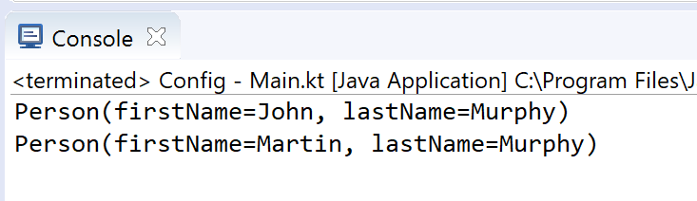
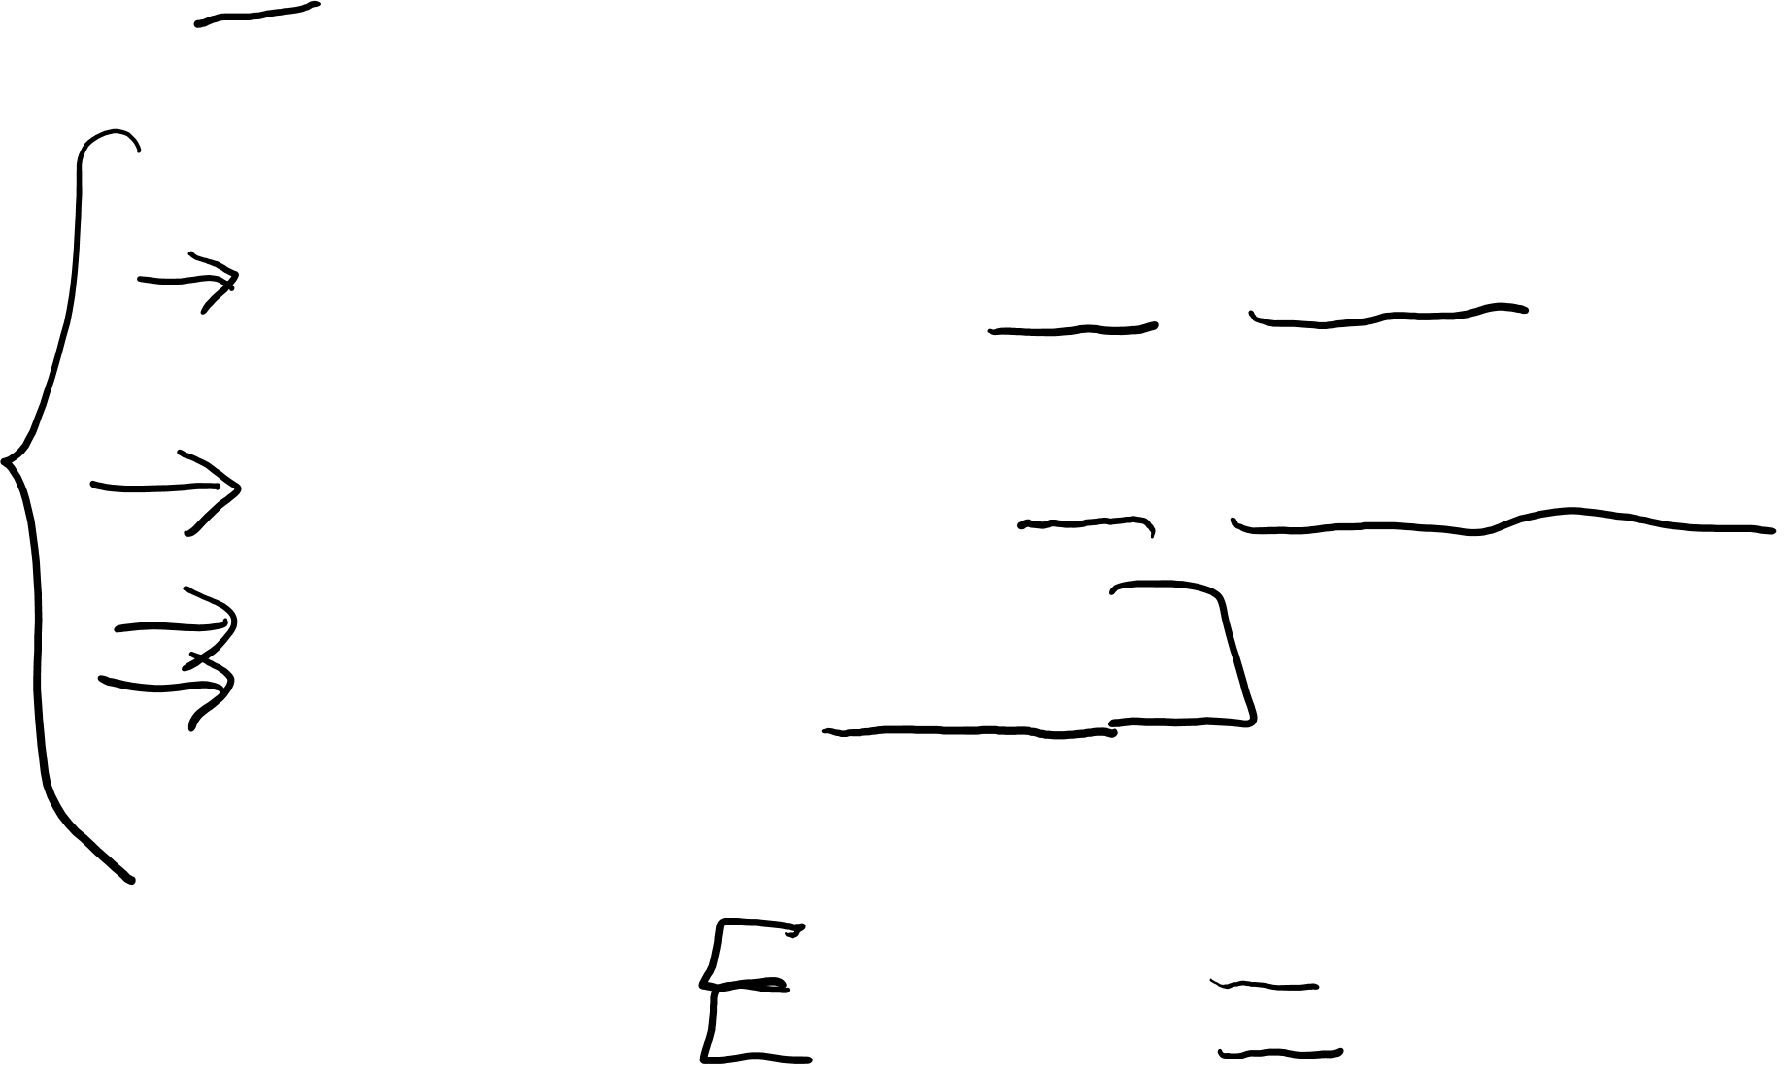
Data Classes – copy and toString Example
data class Person( var firstName: String,
var lastName: String){
}
fun main(args: Array<String>) {
val person1 = Person("John", "Murphy")
// using copy function to create an object
val person2 = person1.copy(firstName="Martin")
println(person1)
println(person2.toString())
}
Notes:
https://www.programiz.com/kotlin-programming/data-class

Slide 20
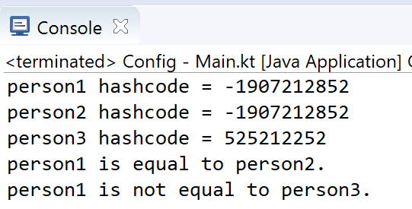
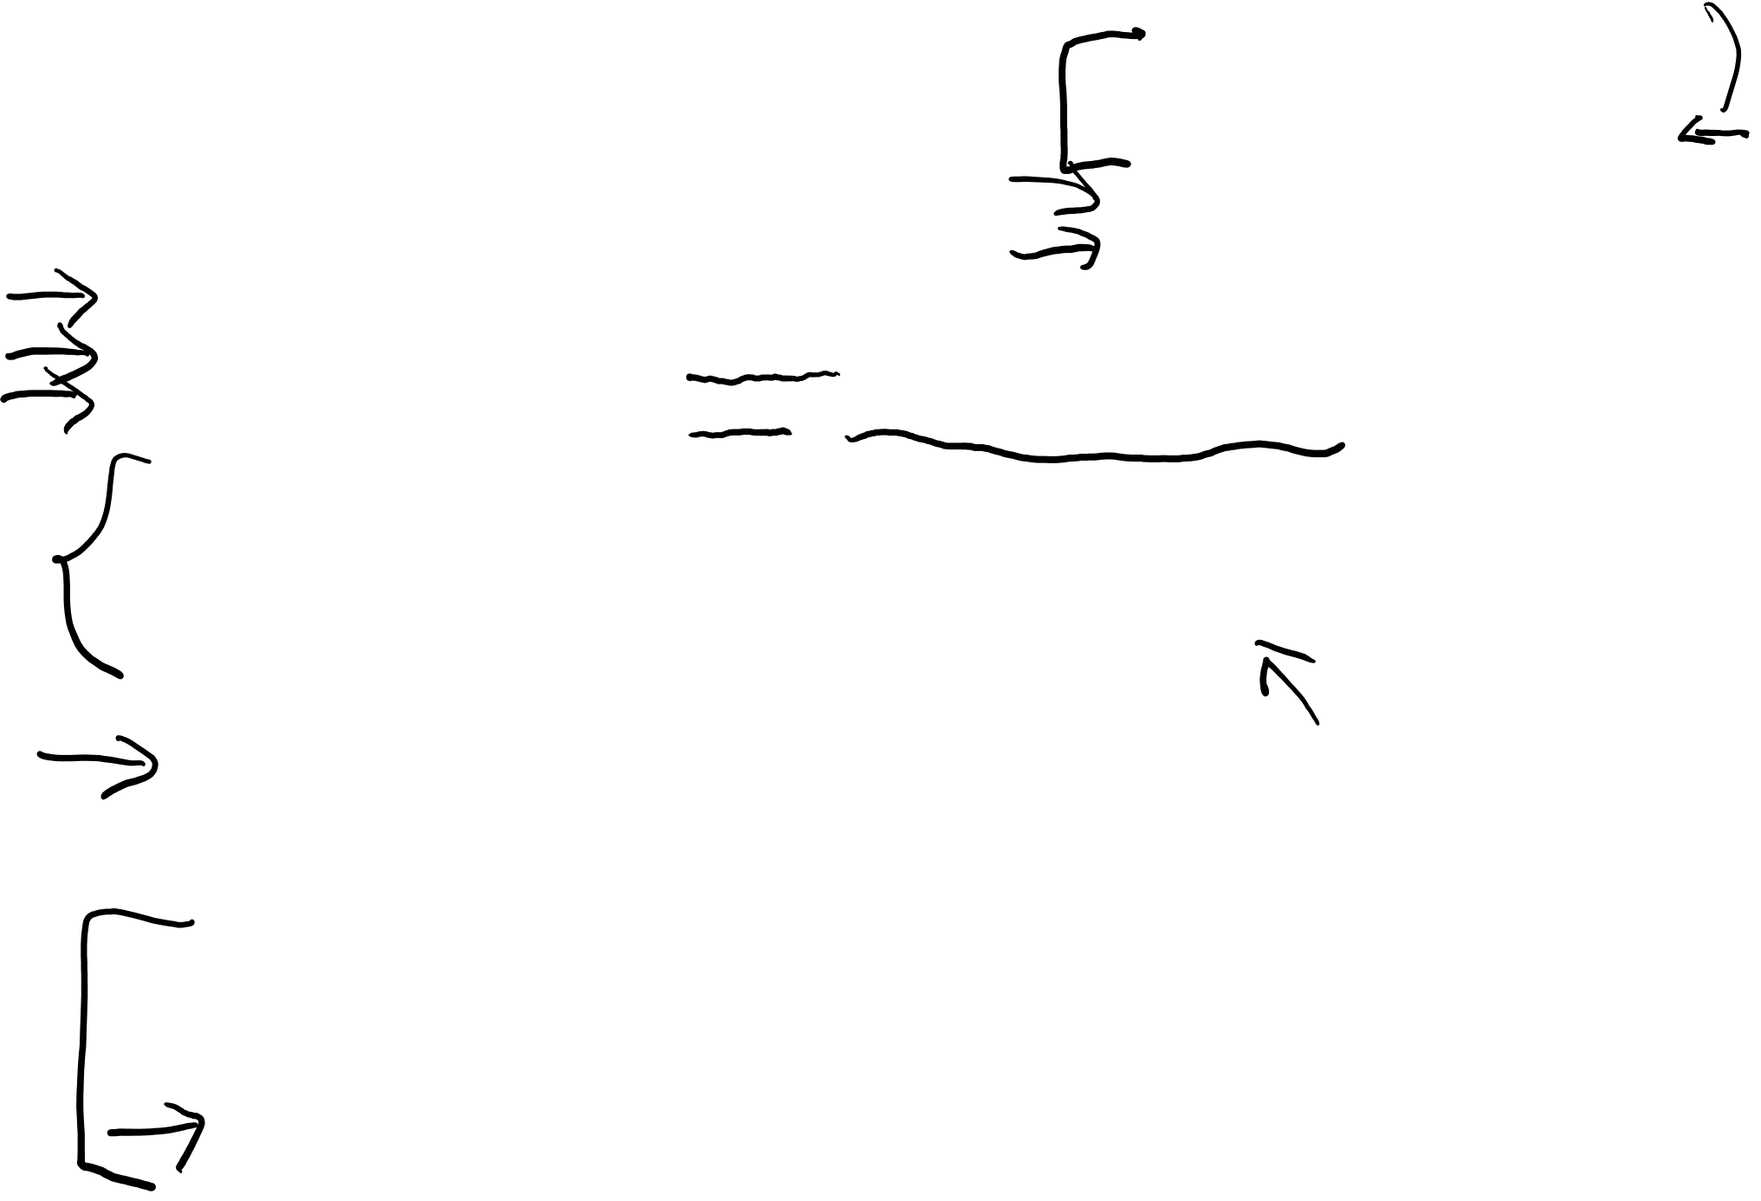
Data Classes – copy, equals and hashCode Example
fun main(args: Array<String>) {
val person1 = Person("John", "Murphy")
val person2 = person1.copy()
val person3 = person1.copy(firstName = "Martin")
println("person1 hashcode = ${person1.hashCode()}")
println("person2 hashcode = ${person2.hashCode()}")
println("person3 hashcode = ${person3.hashCode()}")
if (person1.equals(person2))
println("person1 is equal to person2.")
else
println("person1 is not equal to person2.")
if (person1.equals(person3))
println("person1 is equal to person3.")
else
println("person1 is not equal to person3.")
}
Notes:
https://www.programiz.com/kotlin-programming/data-class

Slide 21
Collections
Arrays and Collections

Slide 22
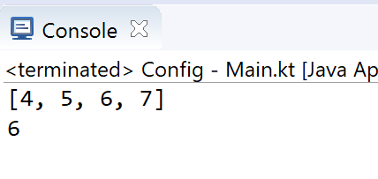

Arrays (using arrayOf)
Arrays in Kotlin can be created using arrayOf() or the Array() constructor.
fun main(args: Array<String>) {
val myArray = arrayOf(4, 5, 6, 7)
println(myArray.asList())
print(myArray[2])
}

Slide 23
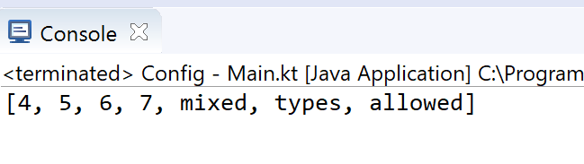
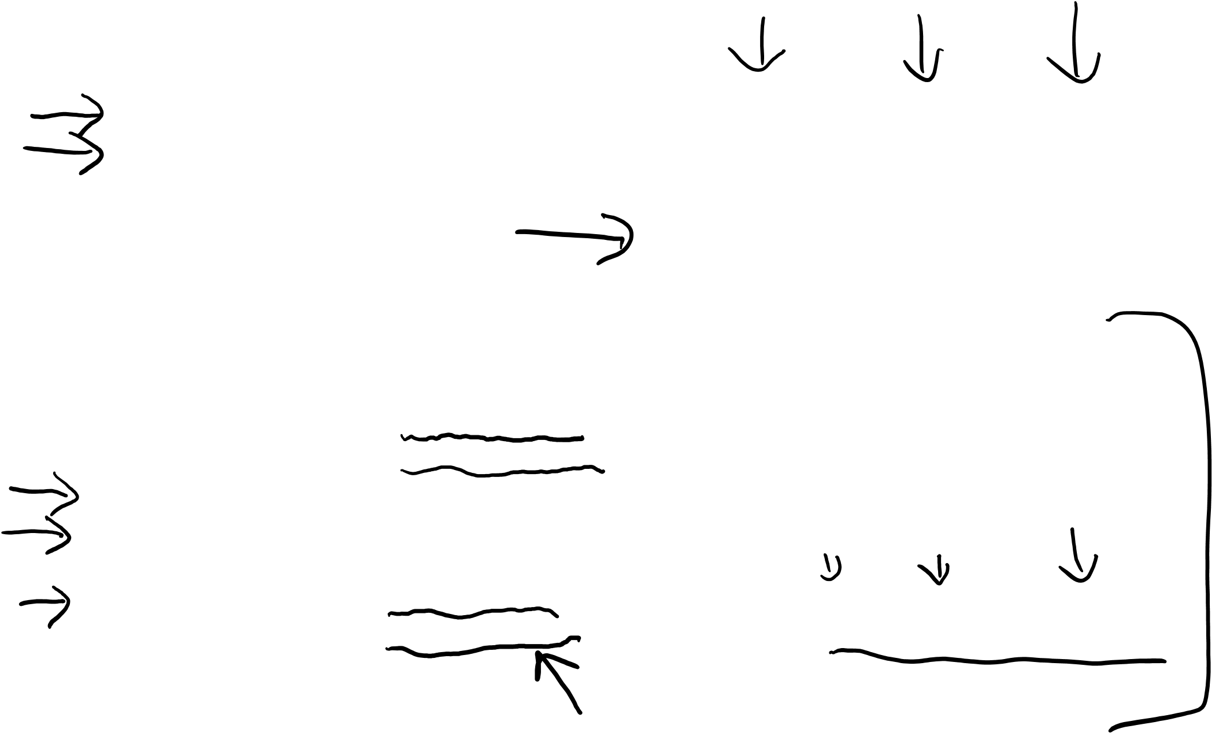
Arrays (using arrayOf)
fun main(args: Array<String>) {
val myArray = arrayOf(4, 5, 6, 7, "mixed", “types", "allowed")
print(myArray.asList())
}
fun main(args: Array<String>) {
val intArray1 = intArrayOf(4, 5, 6, 7)
val intArray2 = arrayOf<Int>(4, 5, 6, 7)
val charArray = charArrayOf('a', 'b', 'c', 'd’)
val booleanArray = booleanArrayOf(true, false, true)
val mixedArray1 = intArrayOf(4, 5, 6, 7, "will","not","compile")
val mixedArray2 = arrayOf<Int>(4, 5, 6, 7,"will","not","compile")
}

Slide 24
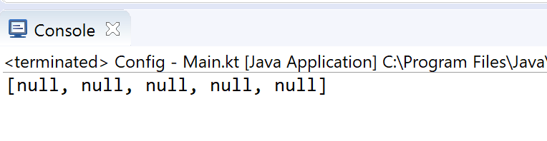

Arrays (using arrayOfNulls)
fun main(args: Array<String>) {
val nullArray = arrayOfNulls<Int>(5);
println (nullArray.asList())
}

Slide 25
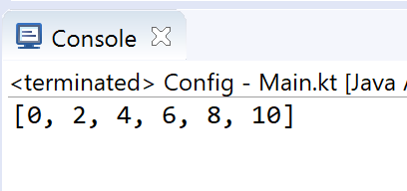
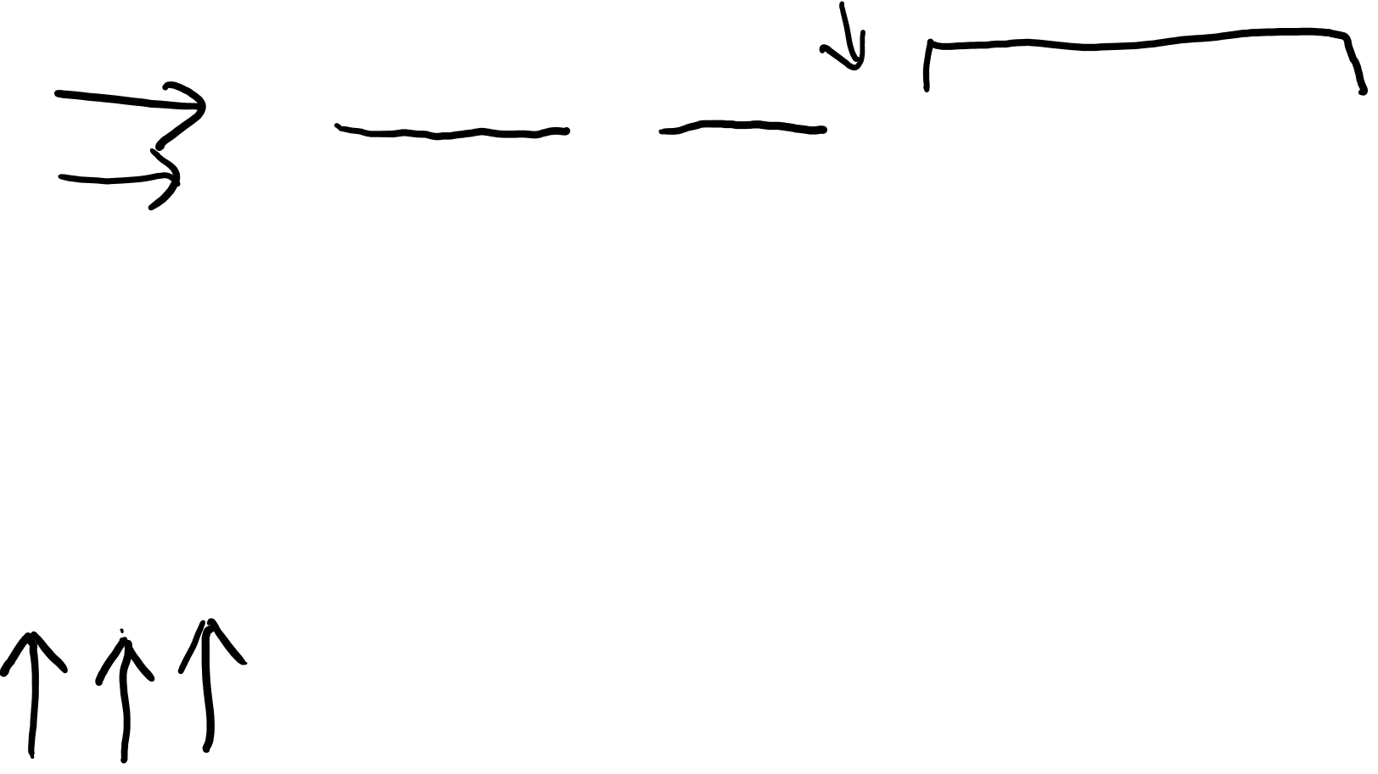
Arrays (using constructor)
The Array() constructor requires a size and a lambda function.
fun main(args: Array<String>) {
val intArray = Array(6, { i -> i * 2 })
print (intArray.asList())
}
Index of the array element
Value to be inserted into the index

Slide 26
Collections
Unlike many languages, Kotlin distinguishes between mutable and immutable collections (lists, sets, maps, etc).
Precise control over exactly when collections can be edited is useful for eliminating bugs, and for designing good APIs.

Slide 27

Collections – mutable vs immutable
The Kotlin List<out T> type is an interface that provides read-only operations like size, get and so on.
Like in Java, it inherits from Collection<T> and that in turn inherits from Iterable<T>.
Methods that change the list are added by the MutableList<T> interface.
This pattern holds also for Set<out T>/MutableSet<T> and Map<K, out V>/MutableMap<K, V>.

Slide 28
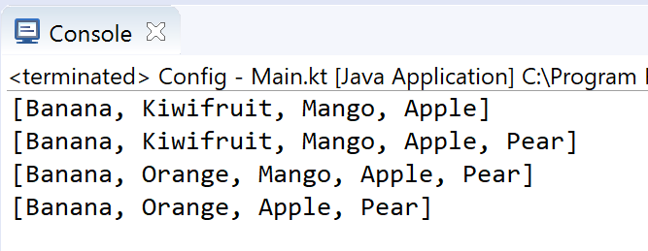
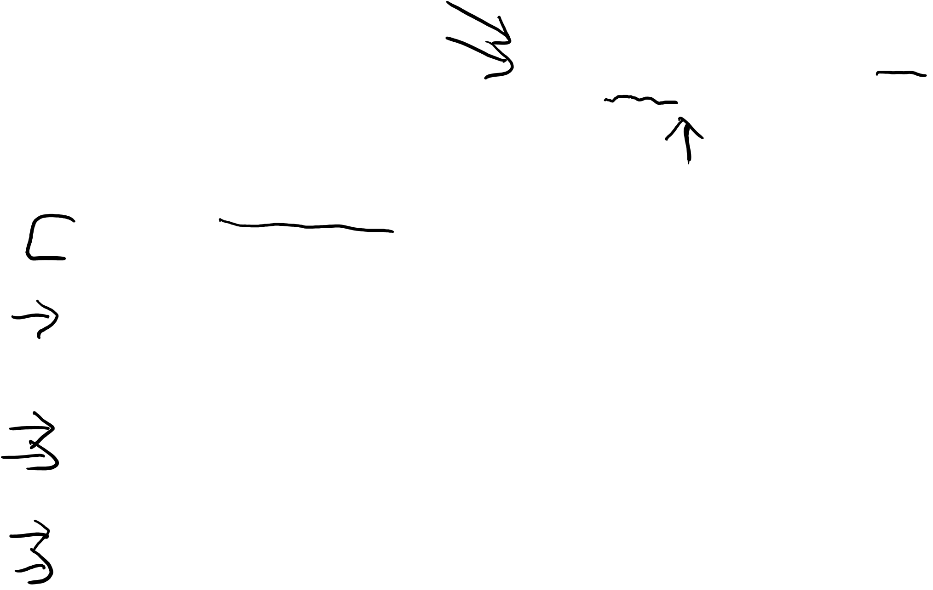
Collections – mutable List
fun main(args: Array<String>) {
// Create a mutable list (MutableList).
val fruit = mutableListOf("Banana", "Kiwifruit", "Mango", "Apple")
println(fruit)
// Add a element to the list.
fruit.add("Pear")
println(fruit)
// Change an element in the list.
fruit[1] = "Orange"
println(fruit)
// Remove a existing element from the list.
fruit.removeAt(2)
println(fruit)
}

Slide 29

Collections – immutable List – example 1
fun main(args: Array<String>) {
val numbers: MutableList<Int> = mutableListOf(1, 2, 3)
val readOnlyView: List<Int> = numbers
println(numbers) // prints "[1, 2, 3]"
numbers.add(4)
println(readOnlyView) // prints "[1, 2, 3, 4]"
readOnlyView.clear() // -> does not compile
}

Slide 30
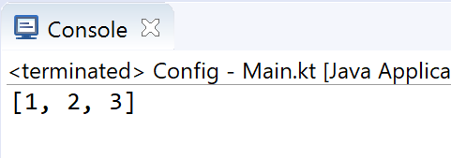
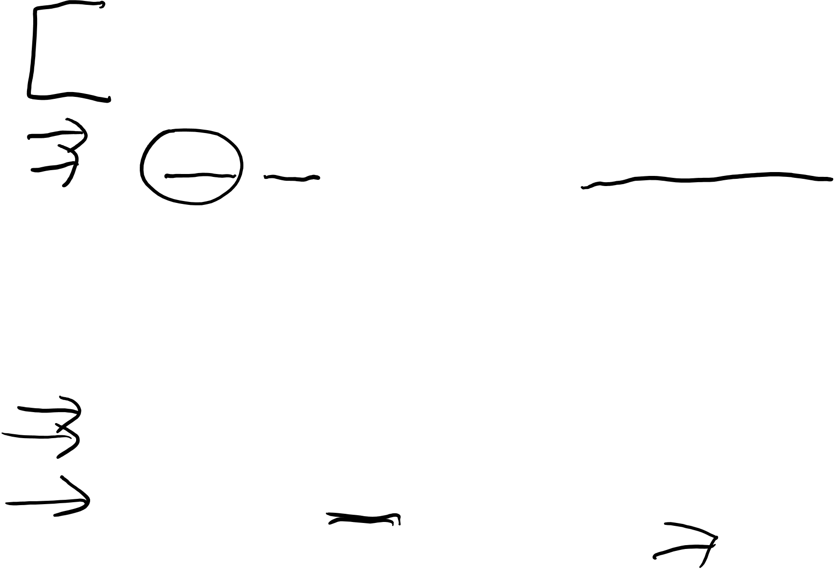
Collections – immutable List – example 2
class Person( _firstName: String = "UNKNOWN",
_lastName: String = "UNKNOWN") {
private val _items = mutableListOf<String>("1", "2", "3")
val items: List<String> get() = _items.toList()
}
items returns a snapshot of a collection at a particular point in time (that's guaranteed to not change). toList() just duplicates the items.
fun main(args: Array<String>) {
val person = Person()
println(person.items)
//person.items.clear() //doesn't compile
}

Slide 31
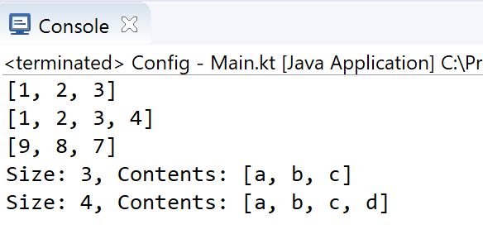

Collections – Set and hashSet
fun main(args: Array<String>) {
// mutatble set
val mutableSet : MutableSet<Int> = mutableSetOf(1,2,3)
println(mutableSet)
mutableSet.add(4)
println(mutableSet)
// immutatble set
val immutableSet : Set<Int> = setOf(9,8,7)
println(immutableSet)
//immutableSet.add(6) //won't compile
//note: ignores duplicate items
val strings = hashSetOf("a", "b", "c", "c")
println("Size: ${strings.size}, Contents: " + strings)
strings.add("d")
println("Size: ${strings.size}, Contents: " + strings)
}

Slide 32
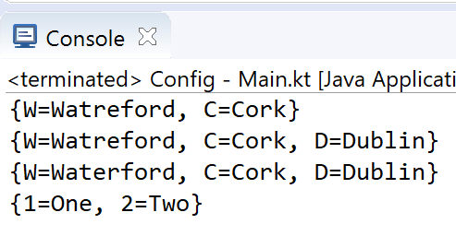

Collections – Map and hashMap
fun main(args: Array<String>) {
// mutatble map
val mutableMap = mutableMapOf("W" to "Watreford", "C" to "Cork")
println(mutableMap)
mutableMap.put("D", "Dublin")
println(mutableMap)
mutableMap["W"] = "Waterford"
println(mutableMap)
// immutatble map
val immutableMap : Map<Int, String> = mapOf(1 to "One", 2 to "Two")
println(immutableMap)
//immutableMap.put(3, "Three") //won't compile
}

Slide 33
Collections
The in operator and using lambdas

Slide 34
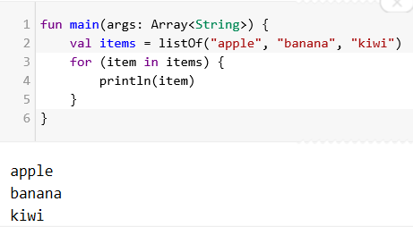

Collections – iterating using the in operator

Slide 35
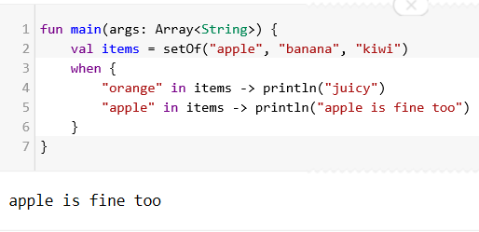

Collections – checking if collection contains an object

Slide 36
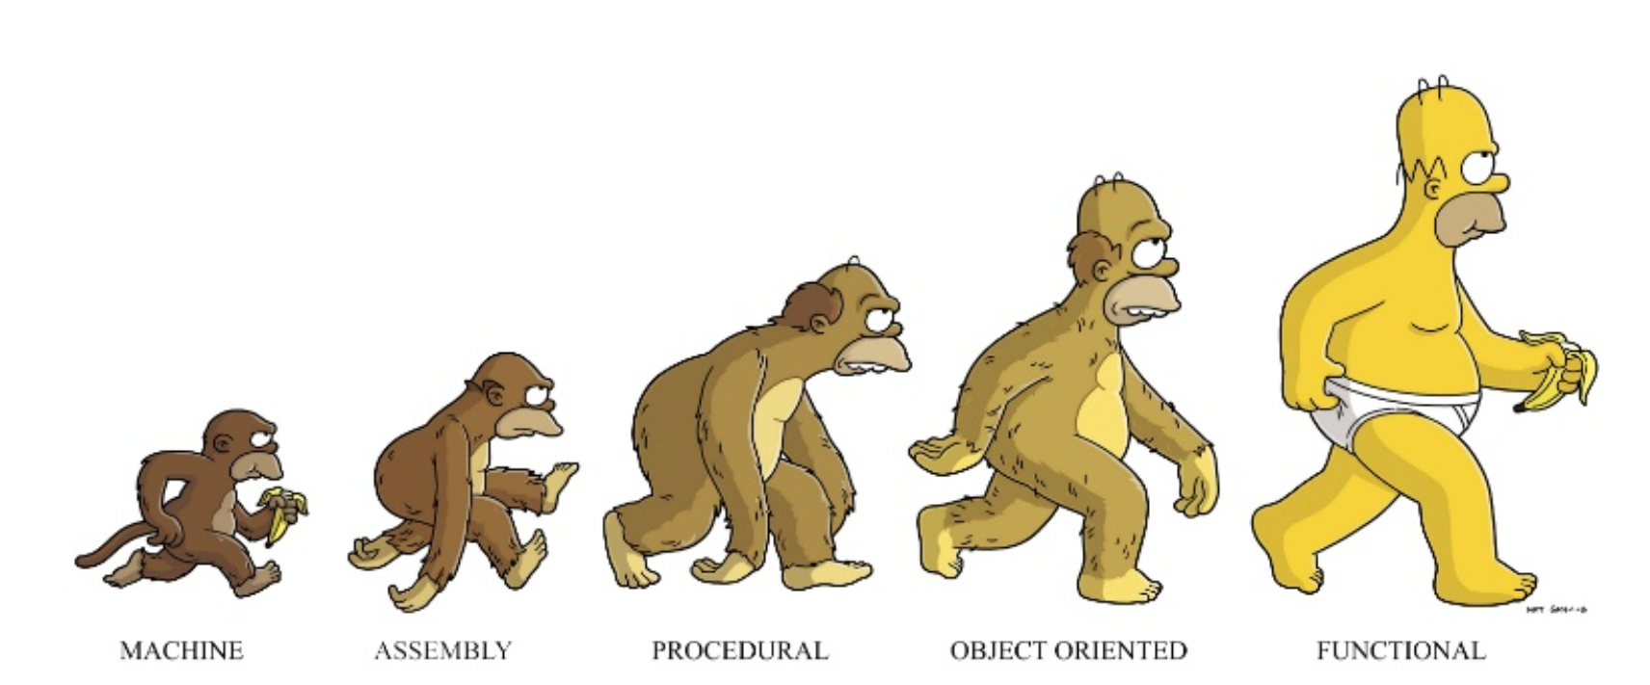

Kotlin….functional programming is prevalent!
Notes:
https://pt.slideshare.net/arnaudgiuliani/kotlin-smarter-development-for-the-jvm

Slide 37

Collections – lambdas
You can pass an anonymous function (a lambda) as a parameter of a function.
A lambda expression is always surrounded by curly braces.
Its parameters (if any) are declared before -> (parameter types may be omitted),
The body goes after -> (when present).
An implicit variable called “it” is created and refers to the lambda expression’s only argument.

Slide 38
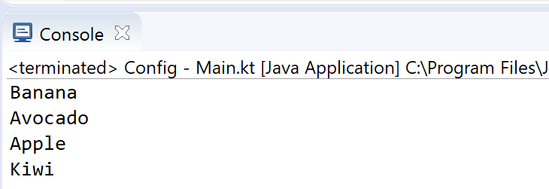
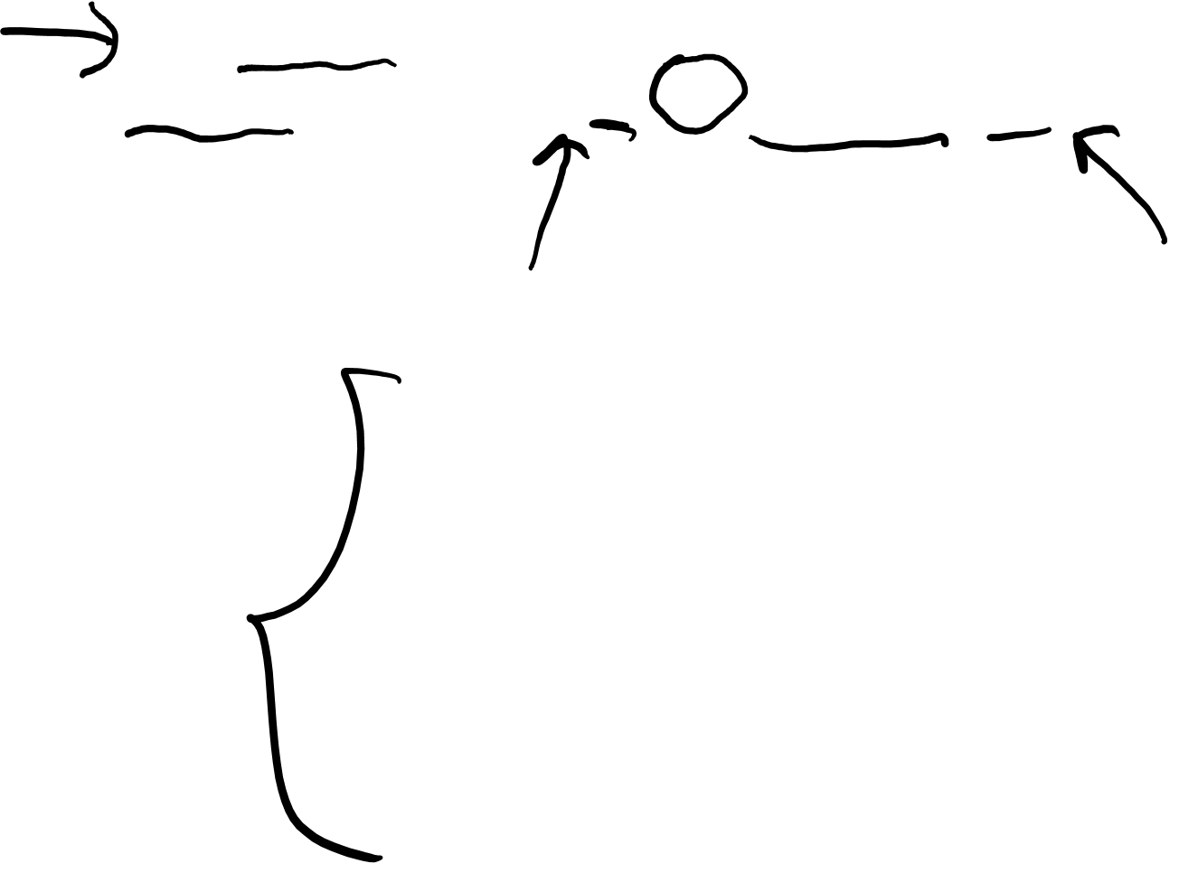
Collections – lambdas
Using lambda expressions to filter and map collections
fun main(args: Array<String>) {
val fruits = listOf ("Banana", "Avocado", "Apple", "Kiwi")
fruits.forEach {it -> println(it)}
}
it -> is optional

Slide 39
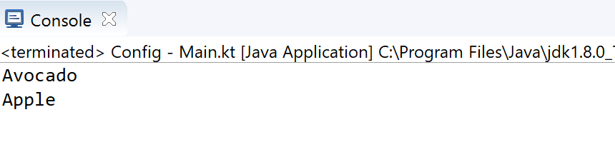

Collections – lambdas
Using lambda expressions to filter and map collections
fun main(args: Array<String>) {
val fruits = listOf ("Banana", "Avocado", "Apple", "Kiwi")
fruits.filter {it.startsWith("A")
.forEach {println(it)}
}

Slide 40
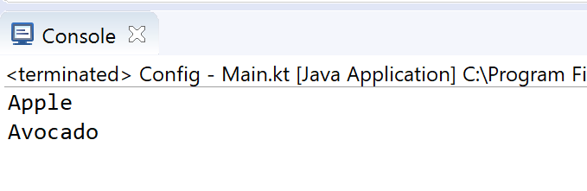

Collections – lambdas
Using lambda expressions to filter and map collections
fun main(args: Array<String>) {
val fruits = listOf ("Banana", "Avocado", "Apple", "Kiwi")
fruits.filter {it.startsWith("A")
.sortedBy { it }
.forEach {println(it)}
}

Slide 41
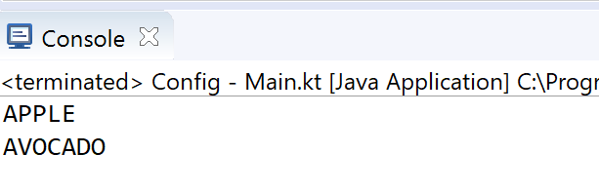

Collections – lambdas
Using lambda expressions to filter and map collections
fun main(args: Array<String>) {
val fruits = listOf ("Banana", "Avocado", "Apple", "Kiwi")
fruits.filter {it.startsWith("A")
.sortedBy { it }
.map {it.toUpperCase()}
.forEach {println(it)}
}

Slide 42
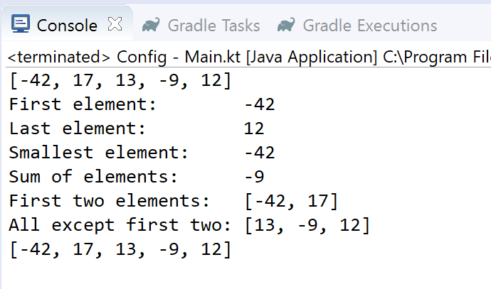

Collections – sample functions
fun main(args: Array<String>) {
val numbers = listOf(-42, 17, 13, -9, 12)
println(numbers)
println("First element: " + numbers.first())
println("Last element: " + numbers.last())
println("Smallest element: " + numbers.min())
println("Sum of elements: " + numbers.foldRight
(0, { a, b -> a + b }))
println("First two elements: " + numbers.take(2))
println("All except first two: " + numbers.drop(2))
println(numbers)
}

Slide 43
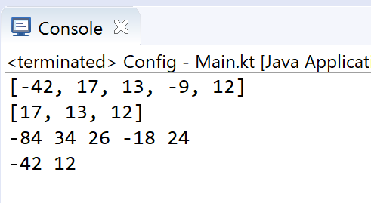
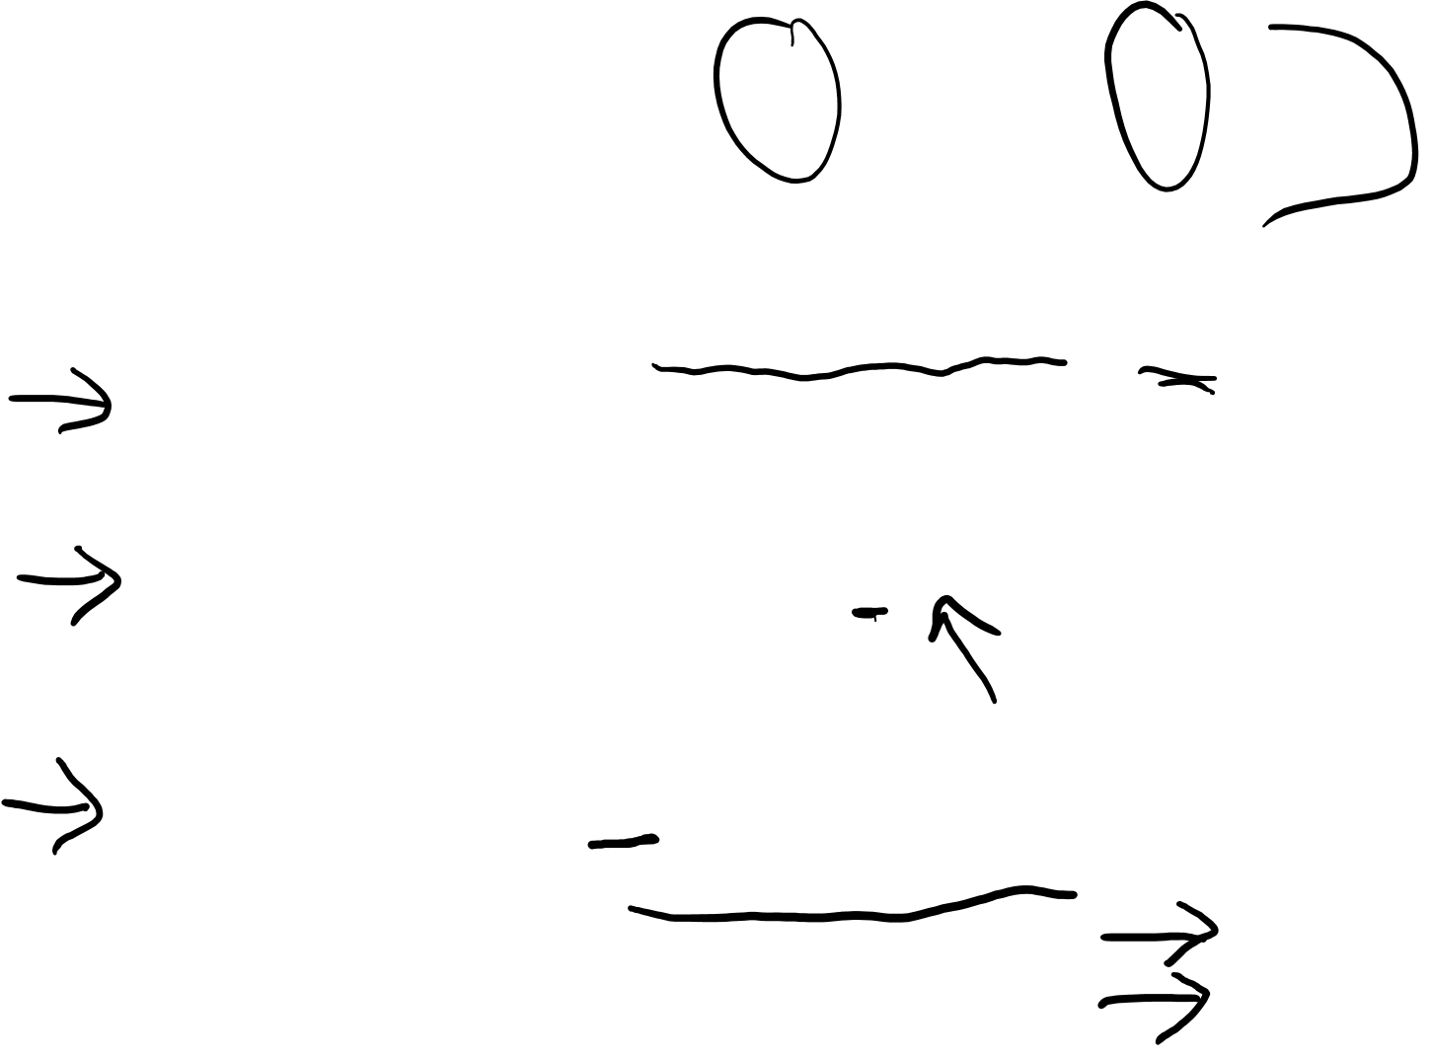
Collections – sample functions
fun main(args: Array<String>) {
val numbers = listOf(-42, 17, 13, -9, 12)
println(numbers)
// New list only containing non-negative numbers
val nonNegative = numbers.filter { it >= 0 }
println(nonNegative)
// Double each element
numbers.forEach { print("${it * 2} ") }
println();
// Output Even elements only
numbers.filter {it % 2 == 0}
.forEach {print ("$it " )}
println();
}

Slide 44
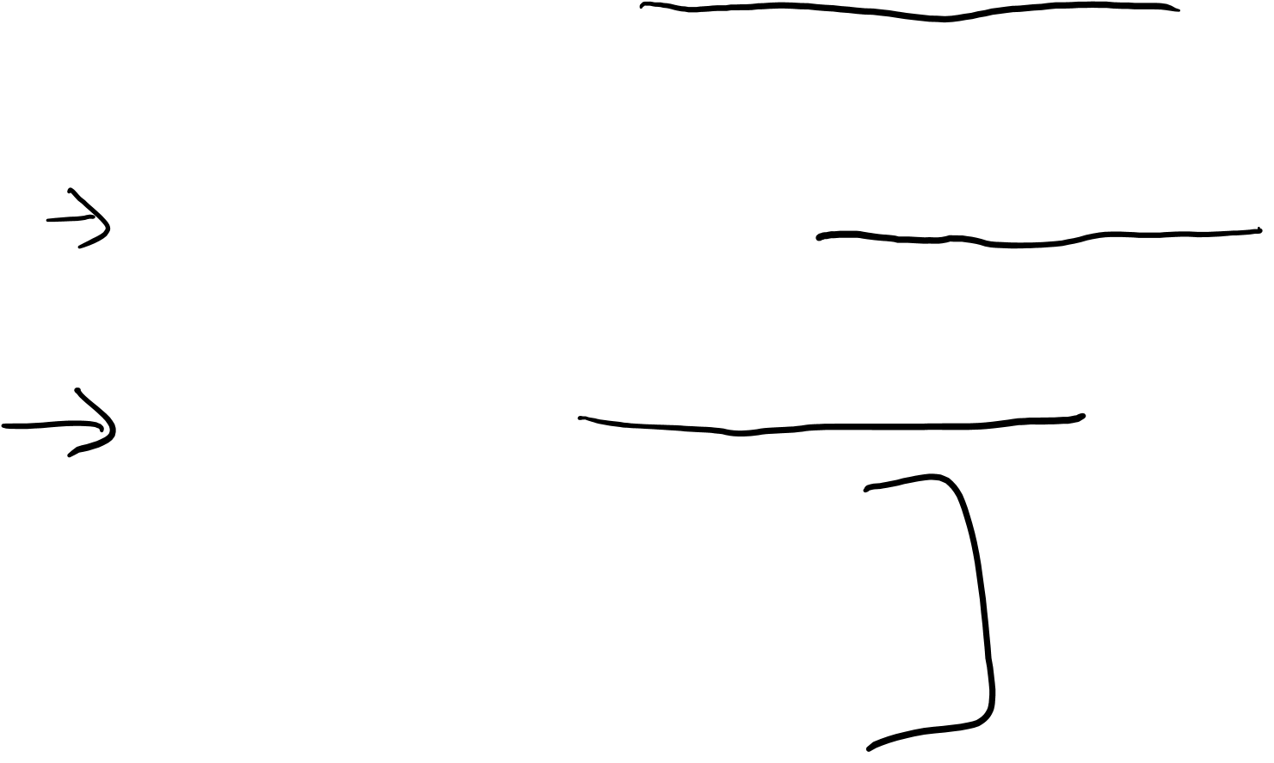
Sets and Lambdas
fun main(args: Array<String>) {
val numbers = setOf(-42, 17, 13, -9, 12)
println(numbers)
// New list only containing non-negative numbers
val nonNegative = numbers.filter { it >= 0 }
println(nonNegative)
// Double each element
numbers.forEach { print("${it * 2} ") }
println();
// Output Even elements only
numbers.filter {it % 2 == 0}
.forEach {print ("$it " )}
println();
}

Slide 45
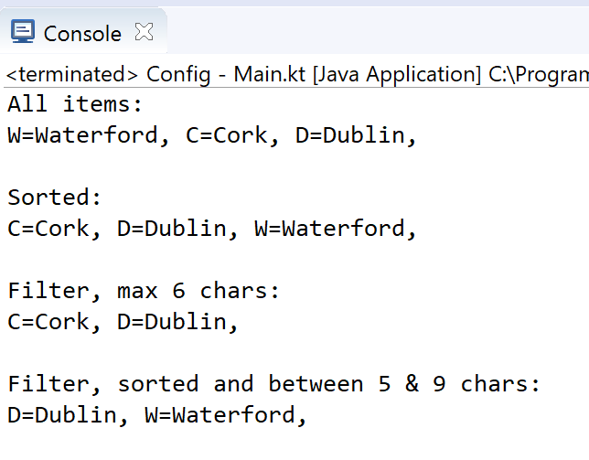
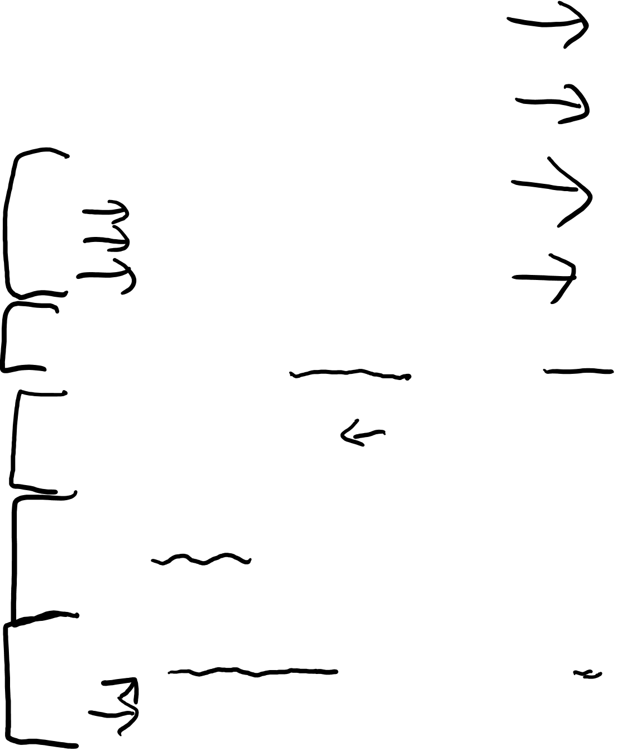
Maps and Lambdas
fun main(args: Array<String>) {
val counties = mapOf(
Pair("W","Waterford"),
Pair("C","Cork"),
Pair ("D","Dublin"))
println("All items:");
counties.forEach {print(it); print (", ")}
println("\n\nSorted:");
counties.toSortedMap()
.forEach {print(it); print (", ")}
println("\n\nFilter, max 6 chars:");
counties.filter {it.value.length <= 6 }
.forEach {print(it); print (", ")}
println("\n\nFilter, sorted and between 5 & 9 chars:");
counties.filterValues {it.length >= 5 && it.length <=9}
.toSortedMap()
.forEach {print(it); print (", ")}
}

Slide 46
Arguments
default and named

Slide 47
Default Arguments (optional)
In Java, you often have to duplicate code in order
define different variants of a method or constructor (i.e. overloading).
Kotlin simplifies this by using default values for arguments (i.e. makes them optional arguments).

Slide 48

Default Arguments (optional)
class NutritionFacts( val foodName: String,
val calories: Int,
val protein: Int = 0,
val carbohydrates: Int = 0,
val fat: Int = 0,
val description: String = "")
{
}
Primary Constructor
Optional
Parameters
val pizza = NutritionFacts("Pizza", 442, 12, 27, 24, "Deep Pan Pizza")
val pasta = NutritionFacts("Pasta", 371, 14, 25, 11)
val soup = NutritionFacts("Soup", 210)
Some possible constructor calls

Slide 49

Named Arguments
class NutritionFacts( val foodName: String,
val calories: Int,
val protein: Int = 0,
val carbohydrates: Int = 0,
val fat: Int = 0,
val description: String = "")
{
}
val pasta = NutritionFacts("Pasta", 371, 14, 25, 11)
val burger = NutritionFacts("Hamburger", calories = 541, fat = 33, protein = 14)
val rice = NutritionFacts("Rice", 312, carbohydrates = 23, description = “Grains")
Naming arguments make your code more readible

Slide 50
Some additional sources for exploration:
Inheritance | https://www.programiz.com/kotlin-programming/inheritance
Interfaces | https://www.programiz.com/kotlin-programming/interfaces
Collections | https://kotlinlang.org/api/latest/jvm/stdlib/kotlin.collections/index.html
Try examples online | https://try.kotlinlang.org/#/Examples/Hello,%20world!/Simplest%20version/Simplest%20version.kt
Encapsulation & Polymorphism | https://medium.com/@napperley/kotlin-tutorial-12-encapsulation-and-polymorphism-6e5a150f25e1
Spek (testing) | https://objectpartners.com/2016/02/23/an-introduction-to-kotlin/ https://github.com/mike-plummer/KotlinCalendar

